Slide 1
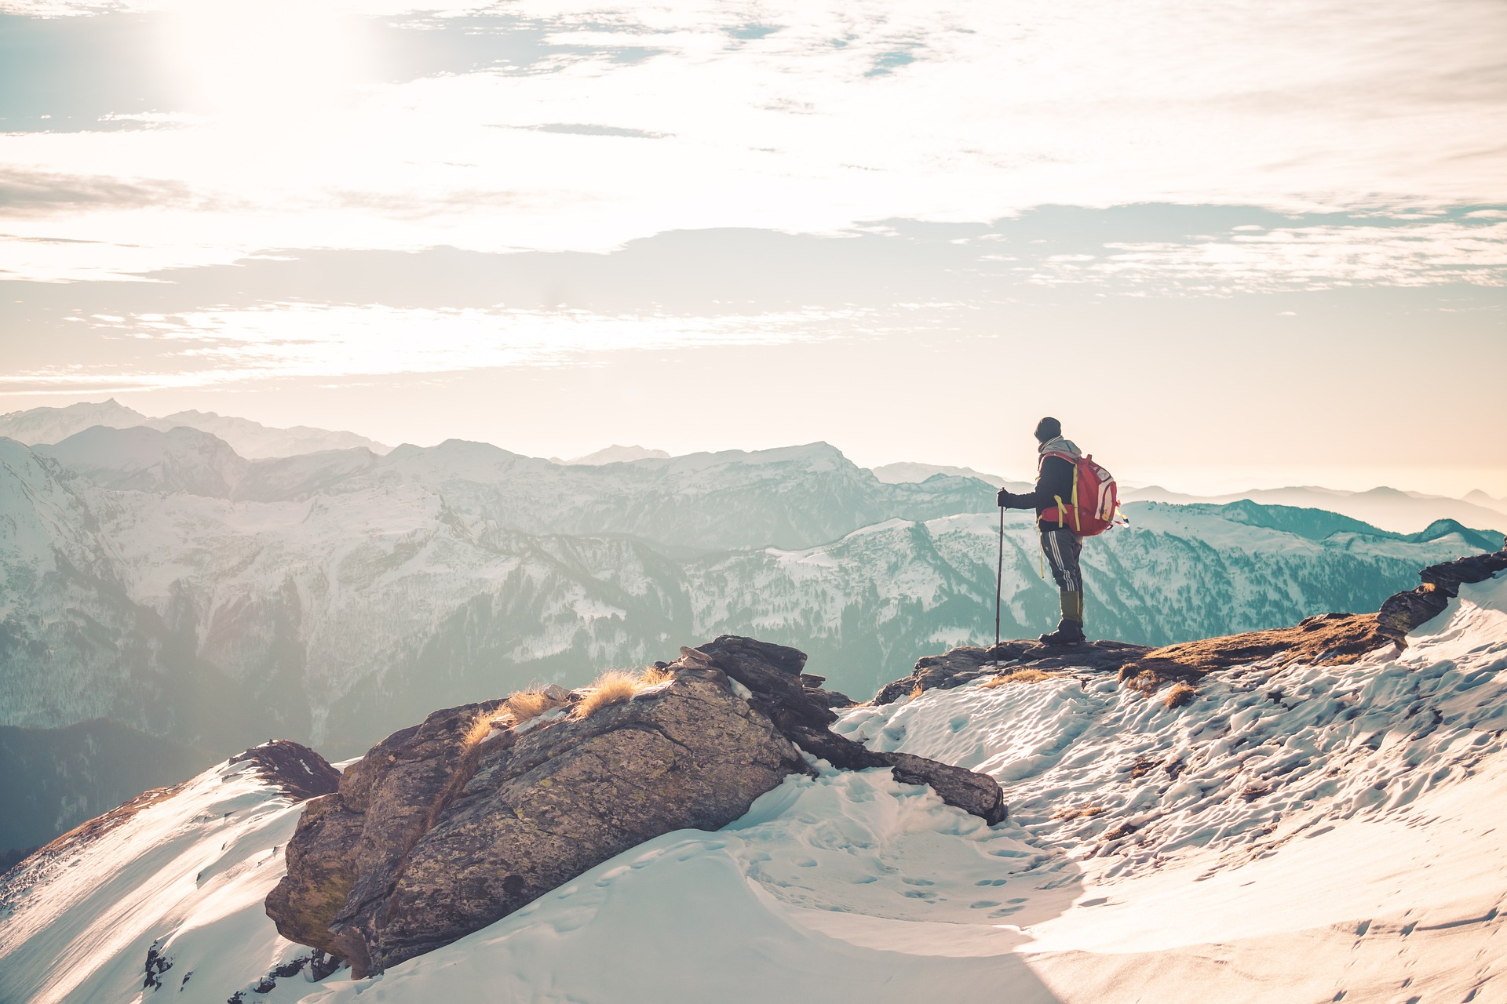
BY: Mohsin Ilyas
18 JANUARY 2024
Kashmir Travels: Explore a World of Adventures

Slide 2
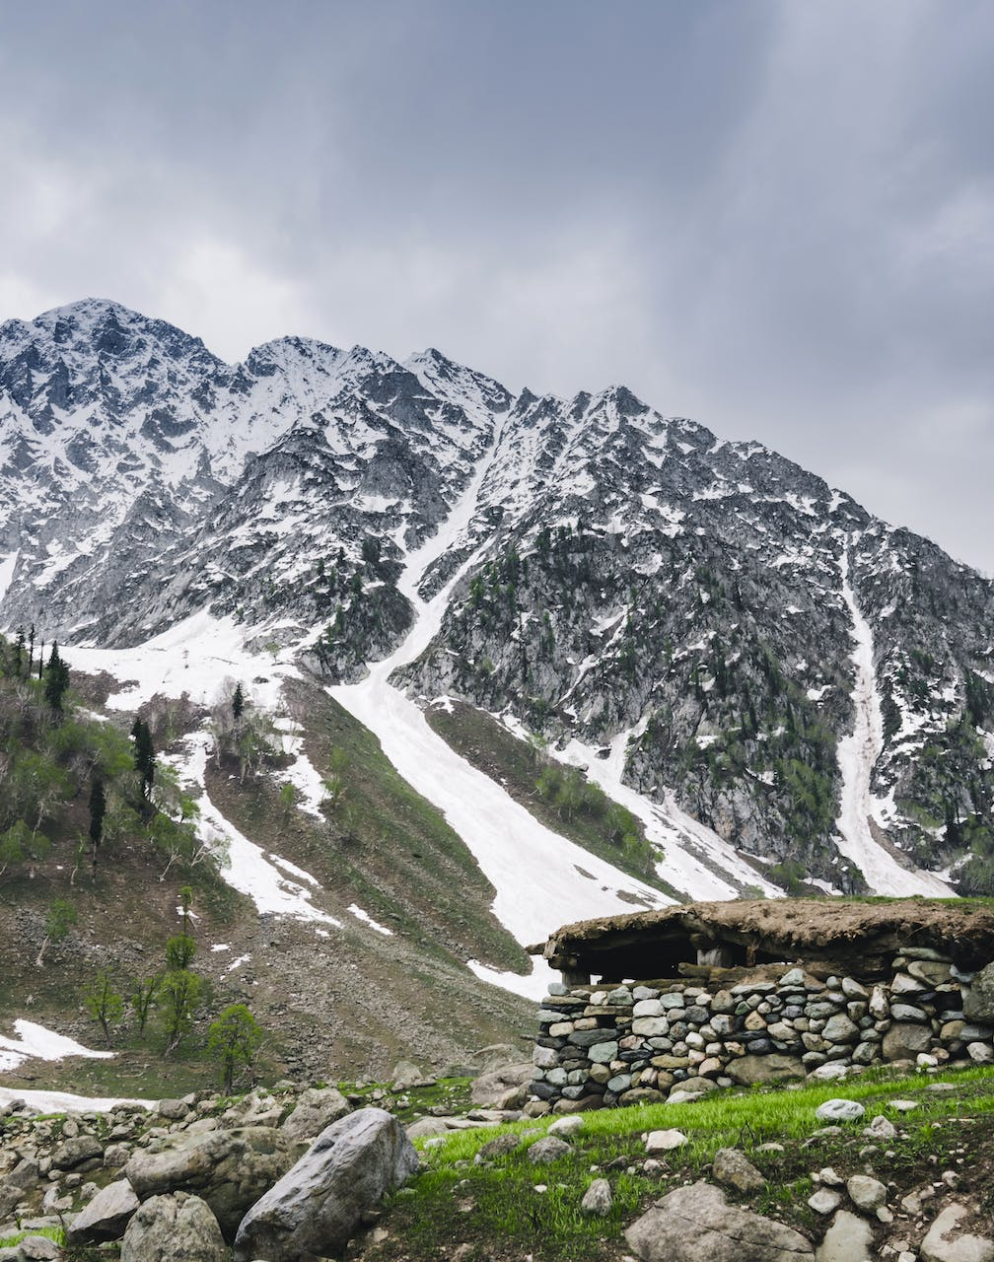
WELCOME TO THE WORLD OF KASHMIR TRAVELS
Embark on a virtual adventure as we introduce a groundbreaking travel platform designed to redefine your exploration experiences.
Introduction
Home Page
Services
About Us
Contact Us

Slide 3



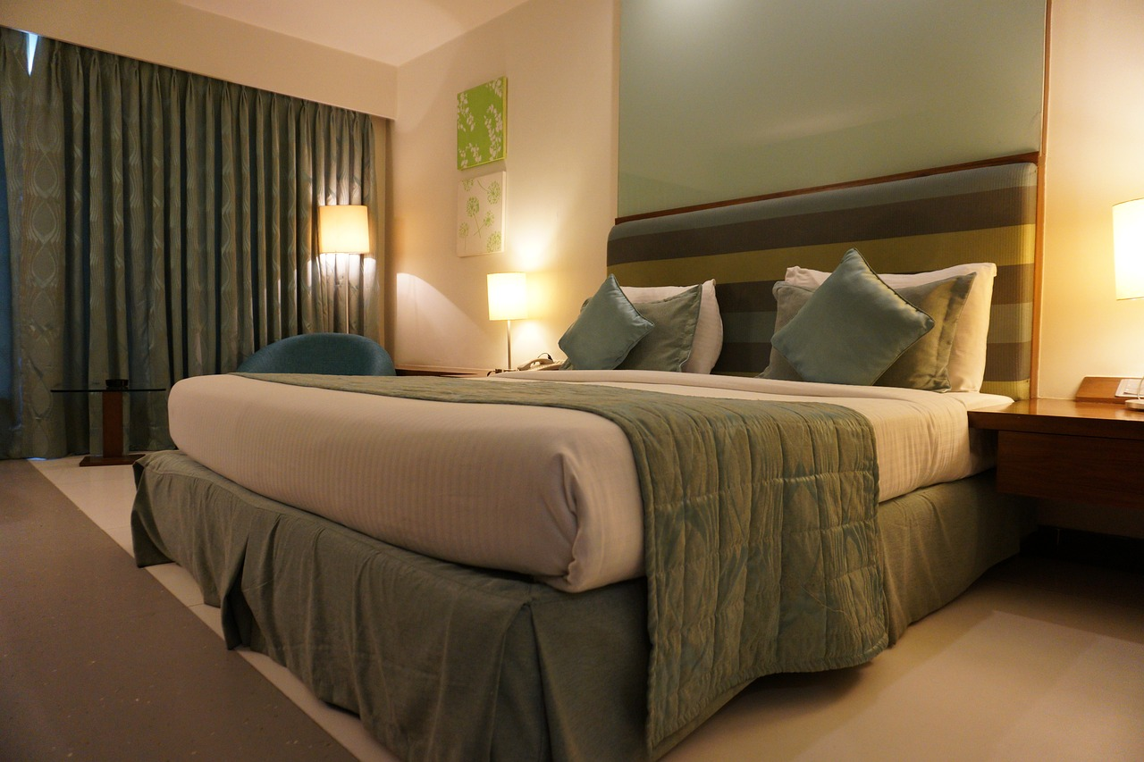
Services
Free Food
Luxury Buses
Free Photography
Luxury Accommodations
Enjoy complimentary and delicious local cuisines during your trip.
Travel in style and comfort with our luxurious and well-equipped buses.
Capture beautiful moments with our professional photography services at no extra cost.
Enjoy the luxury accommodations provided by
Us.

Slide 4
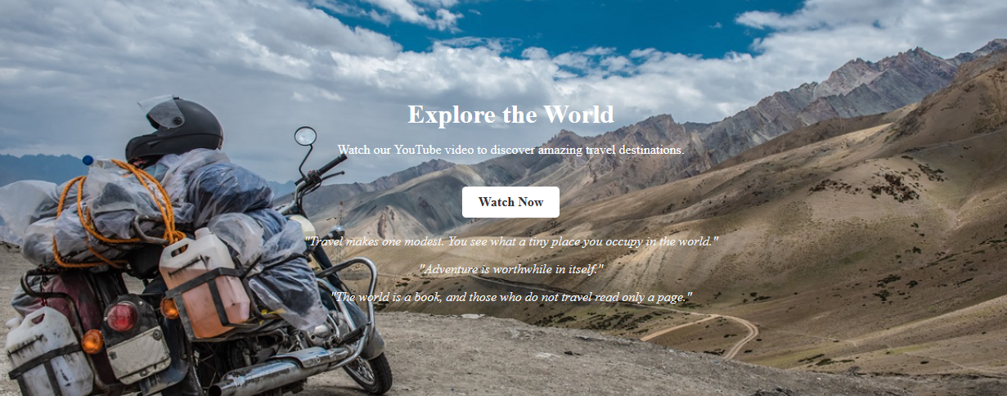
EXPLORE
Explore
Watch our self guided tour on YouTube
“Travel makes one modest. You see what a tiny place you occupy in the world."
"Adventure is worthwhile in itself."
"The world is a book, and those who do not travel read only a page.”

Slide 5
EXCEPTIONAL
About Kashmir Travels
Welcome to KashmirTravels.com! We are a leading travel company providing a wide range of facilities across Kashmir. Our services include traveling, hiking, complimentary food, professional photography, and luxurious hotel accommodations. Our offerings are tailored to meet the diverse preferences and plans of our valued customers.

Slide 6
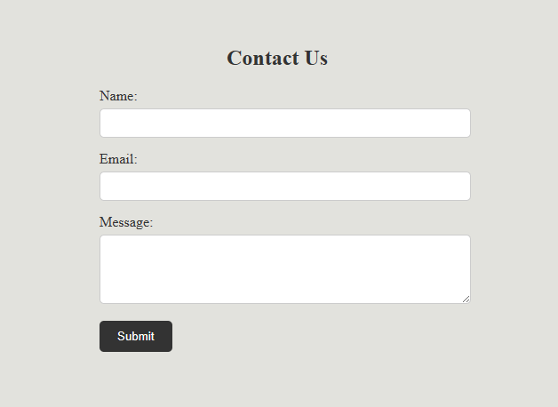
PLAN YOUR VACATION
Contact Us

Slide 7

Quick Links

Slide 8

UNLEASHING THE ADVENTURE
18 JANUARY 2024
EMAIL
mohsinilyas706@gmail.com
PHONE
+923129475171
ADDRESS
Havelian, Abbottabad ,pakistan

Slide 9
Mohsinilyas706@gmail.com
18 JANUARY 2024
THANK YOU

